Slide 1
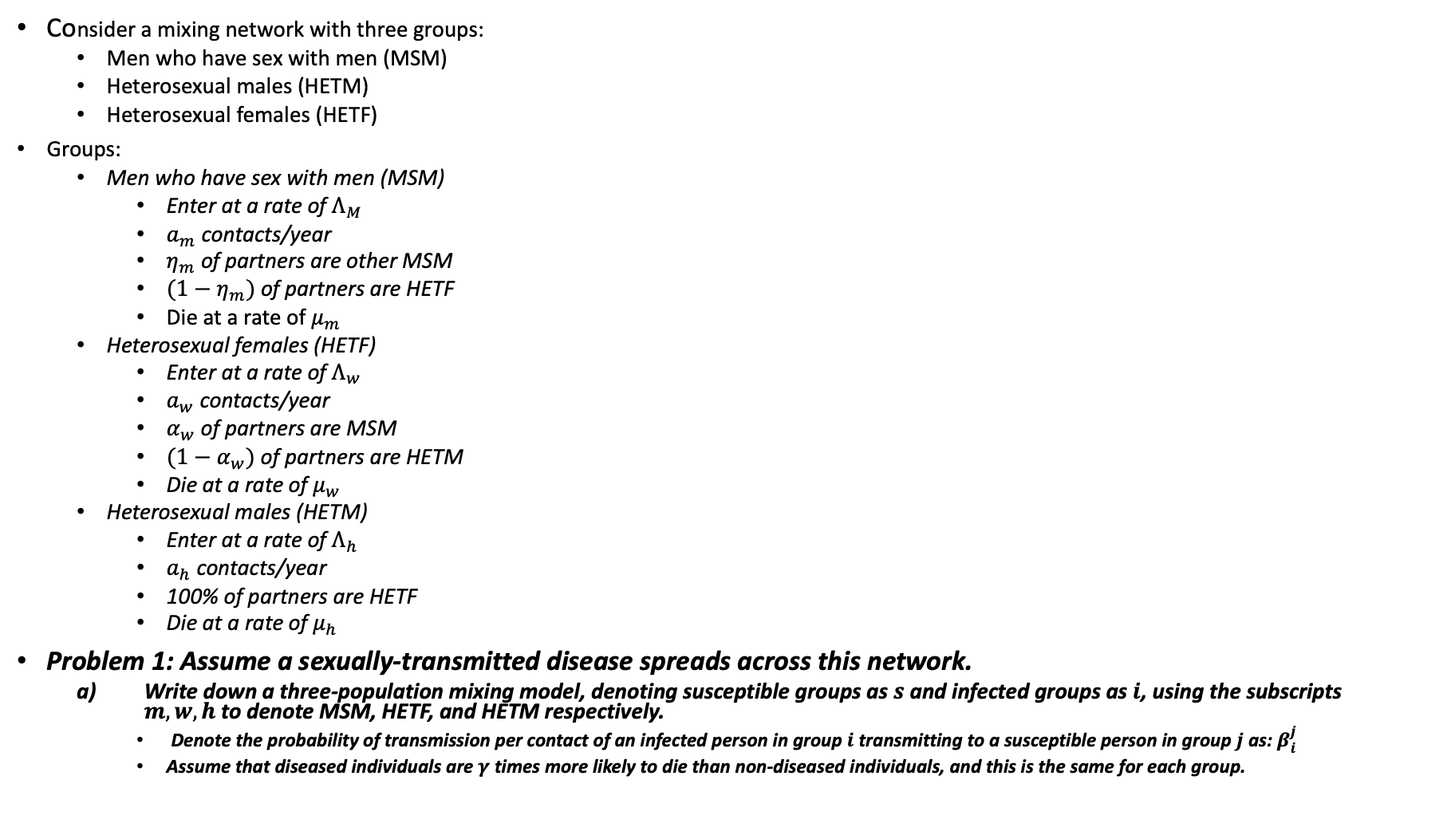
Consider a mixing network with three groups:
Men who have sex with men (MSM)
Heterosexual males (HETM)
Heterosexual females (HETF)
Groups:
Men who have sex with men (MSM)
Enter at a rate of $Λ_{M}$
$a_{m}$ contacts/year
$η_{m}$ of partners are other MSM
$(1−η_{m})$ of partners are HETF
Die at a rate of $μ_{m}$
Heterosexual females (HETF)
Enter at a rate of $Λ_{w}$
$a_{w}$ contacts/year
$α_{w}$ of partners are MSM
$(1−α_{w})$ of partners are HETM
Die at a rate of $μ_{w}$
Heterosexual males (HETM)
Enter at a rate of $Λ_{h}$
$a_{h}$ contacts/year
100% of partners are HETF
Die at a rate of $μ_{h}$
Problem 1: Assume a sexually-transmitted disease spreads across this network.
Write down a three-population mixing model, denoting susceptible groups as $s$ and infected groups as $i$, using the subscripts $m, w, h$ to denote MSM, HETF, and HETM respectively.
Denote the probability of transmission per contact of an infected person in group $i$ transmitting to a susceptible person in group $j$ as: $β_{i}^{j}$
Assume that diseased individuals are $γ$ times more likely to die than non-diseased individuals, and this is the same for each group.
$$η_{m}a_{m}$$
MSM
$$\left(1−η_{m}\right)a_{m}$$
$$α_{w}a_{w}$$
HETF
$$a_{h}$$
$${ (1−α}_{w})a_{w}$$
HETM

Slide 2

Problem 1 (cont.)
We now want to model the effect of pre-exposure prophylaxis (PrEP) on the transmission of the disease. PrEP is a 100% effective treatment that, if taken, guarantees that one cannot catch the disease. Letting $ε_{j}$ denote the fraction of the susceptible population $j$ on PrEP, modify the model to account for the effect of PrEP.

Slide 3
Problem 2
Using the model in Problem 1, and information on the following slide, implement the model in MATLAB over a 20 year period with the following initial conditions:
$\left[S_{m};I_{m};S_{w}; I_{w};S_{h};I_{h}\right]=\left[165,000; 36,000;3,300,000;15,000;3,250,000;9,500\right]$
Assume 11,000 initial PrEP users among MSM, 1,000 among HETF, 0 among HETM
Note: Assume, for simplicity, that the PrEP fraction at the initial time remains fixed
How many cumulative new infections are there, for each group, over a five, ten, and twenty year periods.
Run each model scenario again three separate times:
First time, add 50,000 PrEP users to MSM population at t, with HETM and HETF populations the same as before
Second time, add 50,000 PrEP users to HETF population (MSM and HETF same as before)
Third time, add 50,000 PrEP users to HETM population (MSM, HETF assume zero users)
Assume, for simplicity, that the population PrEP fractions remain fixed over the entire simulation period
How many cumulative new infections are there, for each group, over a five, ten, and twenty period in each scenario?
What does this suggest is the most effective allocation of PrEP?

Slide 4
Parameter list values
Males have a .009 probability of death in a year
Females have a .008 probability of death in a year
2000 new MSM, 32500 HETF, and 31500 HETM become active each year
85.1% of MSM contacts are with other MSM, 2% of HETF contacts are with MSM
MSM, HETF, and HETM have 120, 47.2 and 47 contacts / year, respectively
The probability of an infected male transmitting to a susceptible male is .0007/contact, probability of an infected male transmitting to a susceptible female is .0004/contact, and the probability of an infected female transmitting to a susceptible male is .0003/contact

Slide 5
Problem 3
Using methods shown in class, derive the sensitivity equations for the model to the PrEP fractions $ε_{j}$ for each group.
You may consider the overall populations sufficiently constant such that the denominator (total population) may be combined
Plot the sensitivity in the infected compartment, for each group $k$, to the number on PrEP in each respective group $j$
Hint: make sure to adjust the final sensitivities is so that they reflect NUMBERS on PrEP, not FRACTIONS on PrEP
Is this consistent with your findings in Problem 2? Why or why not?

Slide 6
Problem 4
This last problem concerns the use of DMD
For the initial setup (11,000 MSM PrEP users, 1,000 HETF, 0 HETM), simulate the first three years of the 20-year period (using a time-step size of $Δt=5 days$).
Then, use DMD to project the following 17-years using 1, 2, 3, 4, 5, and 6 DMD modes. Plot the relative error in time for $I_{m}, I_{w}, I_{h}$ for each DMD reconstruction over the time-period
Next, perform the same procedure but for the case in which 50,000 PrEP users are added to the MSM population. How do the results differ?

